Slide 1
Near Real Time Daily Actual Evapotranspiration(AET) Product under National Hydrology Product (NHP)
Prepared By:
Water Resources Informatics Division (WRID)
Water Resources Group (WRG)
Remote Sensing Applications Area (RSAA)
National Remote Sensing Centre (NRSC)
Indian Space Research Organization (ISRO), Hyderabad

Slide 2
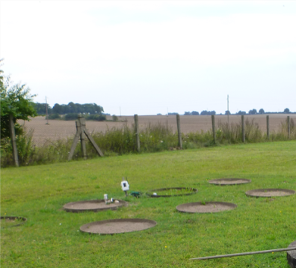
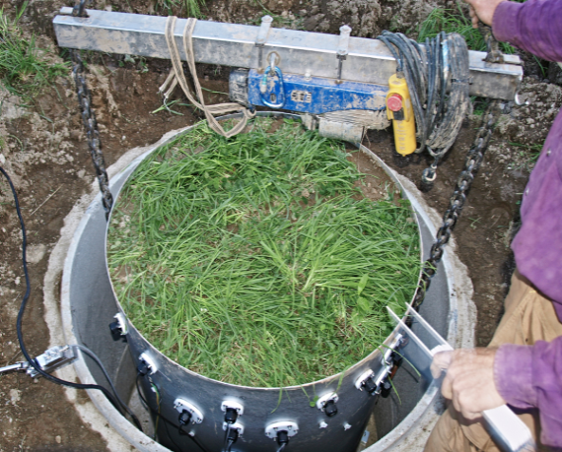
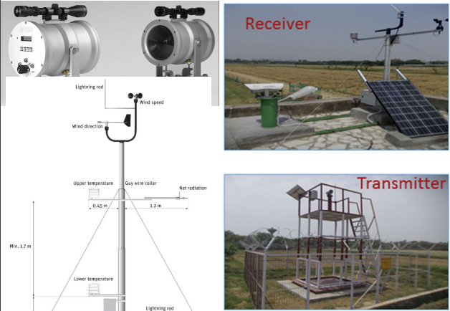
Traditional Evapotranspiration Measurement Techniques
Weighing Lysimeter : Point based measurement
Spatial measurement is possible but with very limited spatial coverage
Open Path Eddy Covariance System (Flux tower)
Large Aperture Scintillometer (LAS)

Slide 3
Evapotranspiration estimation based on Satellite Remote Sensing data
Provides reasonable estimate of evapotranspiration over spatial region
Repetitive coverage of spatial region is possible
Cost‐effective method to estimate evapotranspiration at regional scale
Enhance capabilities for monitoring of the water cycle from space
Useful for quantify crop water consumption at regional and field scales

Slide 4
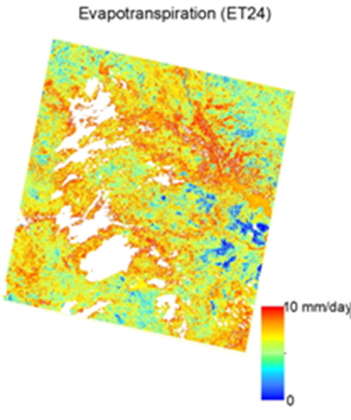
Currently available Actual Evapotranspiration (AET) products
1 km SSEBop Monthly AET product
500 meter MODIS 8 day AET product
16 day experimental Landsat based AET product (eeflux)
30 meter spatial resolution but limited spatial coverage

Slide 5
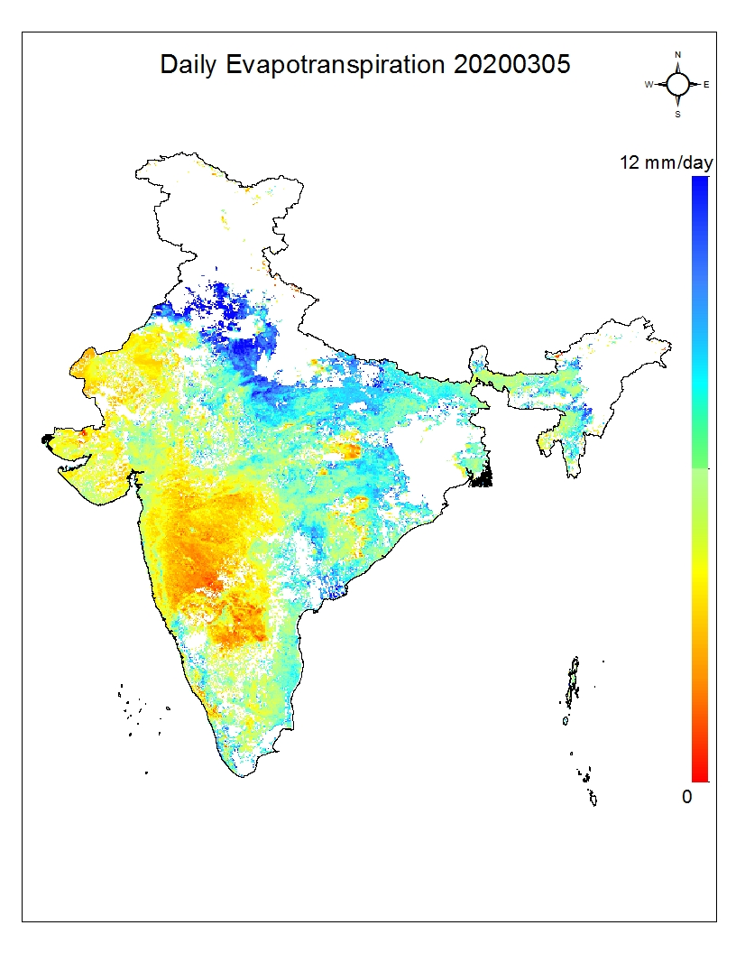
Actual Evapotranspiration product developed by NRSC
Near real time daily Actual Evapotranspiration (AET) product
Coverage: Indian Region: 5⁰-38⁰ latitude and 66⁰-104⁰ longitude
Spatial Resolution : 0.05 degree (5.5X5.5 Km² )
Temporal resolution : Daily
Format : Geotiff
Lag time : 3 days
Input: Satellite and meteorological datasets
Daily AET product generated for 05 March 2020

Slide 6
AET Product generation Methodology
Energy Balance Approach
R_{n} - Surface net radiation
λE - Latent heat flux
H - Energy flux that heats the air/sensible heat
G - Heat of conduction to ground
Modified Priestley Taylor algorithm
Modified form of Surface energy balance equation
Only two meteorological inputs
Remaining inputs from remote sensing satellite
Computation time is less
α_{e} - (0 ~ 1.26) Modified Priestley Taylor parameter(related to surface condition)
R_{n} - Net radiation
G - Soil heat flux
Δ - Gradient of saturated vapour pressure at a certain air temperature
γ - Psychrometric constant

Slide 7
Input data Sets for Algorithm
Satellite Platform : NPP Suomi
Acquired and Processed data at NRSC Hyderabad
Obtained Parameters : Land Surface Temperature (LST) , Normalized Difference Vegetation Index (NDVI), Albedo and Cloud mask
Spatial resolution : 375 meter- 750 meter
Temporal Resolution : Daily 2 passes to cover Indian region
Satellite Platform : INSAT 3D
Data from MOSDAC server SAC Ahmadabad
Obtained Parameters : Insolation (INS) , Out going longwave radiation (OLR)
Spatial resolution : 4Km-5.5 Km
Temporal Resolution : half hourly interval (entire Indian region)

Slide 8
Input data Sets for Algorithm
Meteorological data
Data from IMD stations (NRSC server) and Global (NOAA) datasets
Obtained Parameters : Air temperature, Dew point Temperature
Spatial resolution : Point/Station data
Temporal Resolution : Hourly interval
Fixed Input
Elevation data : CARTO DEM
Region of interest : Indian region

Slide 9
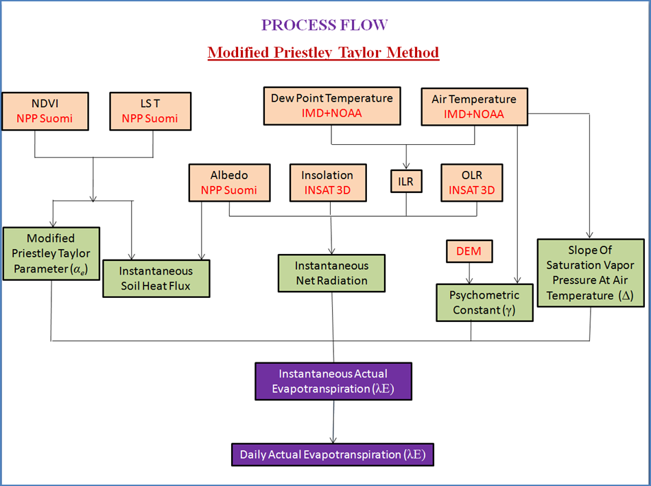
Process flow diagram for operational product generation

Slide 10
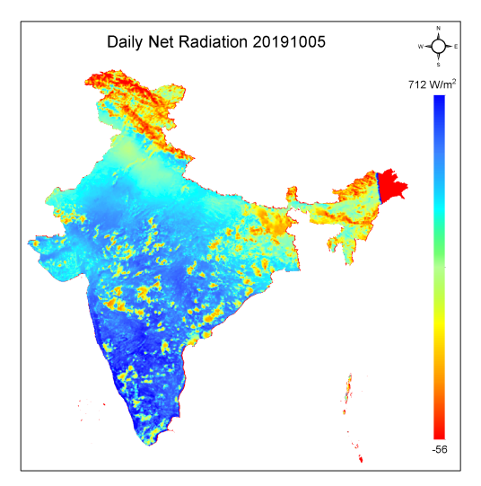
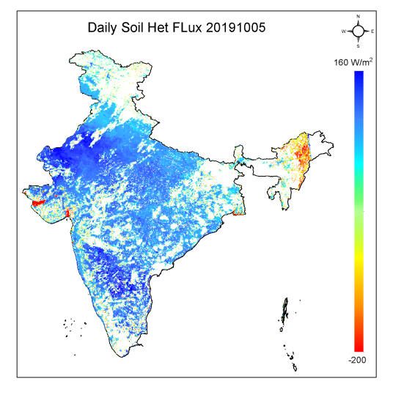
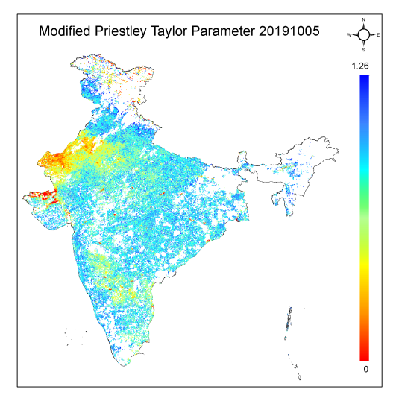
Intermediate output product
Estimated Daily Average Net radiation for 05.10.2019
Estimated Daily Average daily soil Heat Flux for 05.10.2019
Estimated Modified PT parameter for 05.10.2019 from the NDVI –LST triangle

Slide 11
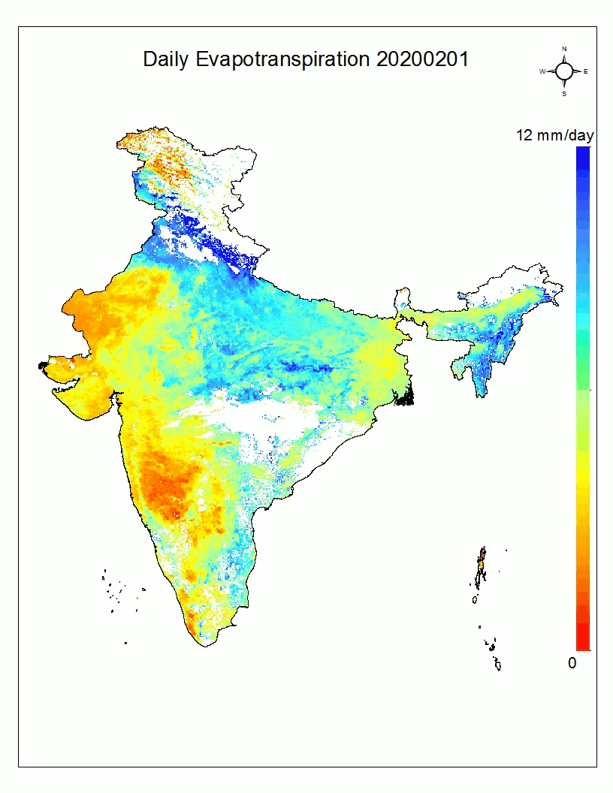
Animated AET maps ( Feb 2020 – Mar 2020)
Experimental daily AET product is being generated operationally at 5.5 km² spatial resolution under National Hydrology Project from April 1, 2019.

Slide 12
Product limitation
Product is generated for the clear sky condition.
Algorithm is valid for vegetation only .
AET over water and snow pixels is not valid.
Daily AET consists of integration of satellite time pass value over the day length (sunset to sun rise).
Night time evapotranspiration is negligible.

Slide 13
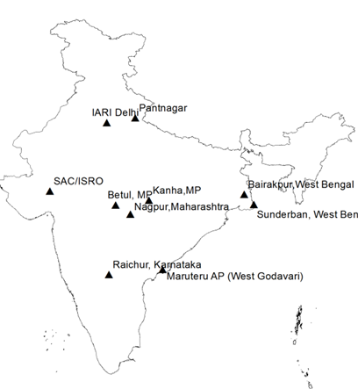
Plan for validation of the satellite derived AET product
Ground based instrumentation will be established for calibration and validation of satellite derived AET product.
10 Numbers of Open path Eddy Covariance System (flux towers) and Large Aperture Scintillometer (LAS) will be installed in country based on agro ecological region , climate zones , soil types and type of cropping system.
Existing flux towers in country under ISRO

Slide 14
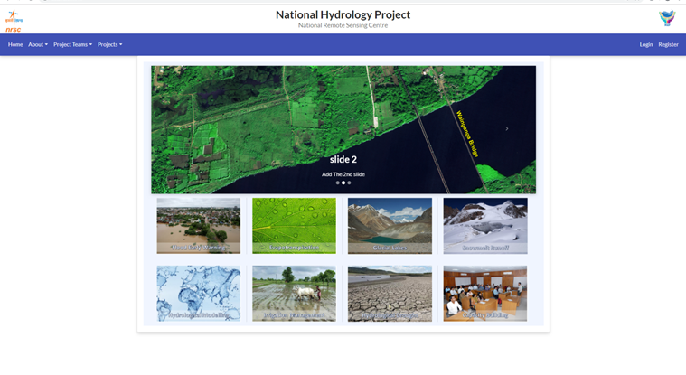
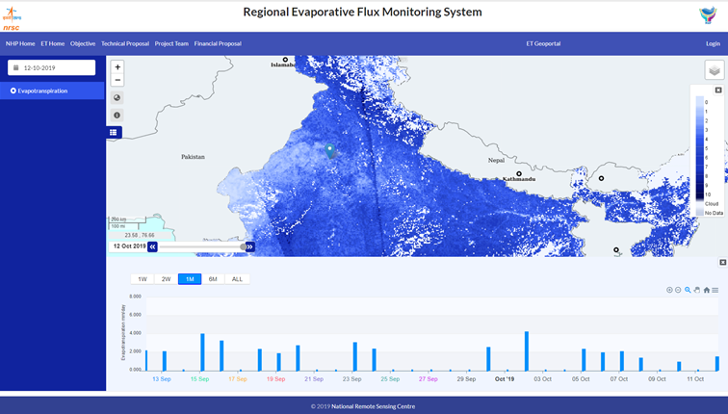
Data dissemination through NRSC NHP Geo portal
web GIS based ET Geo portal for product visualization
Current Status
Temporal variation of AET at any Specific point (latitude and longitude)
In future
Long-term ET data
Aggregation at various spatial unit

Slide 15
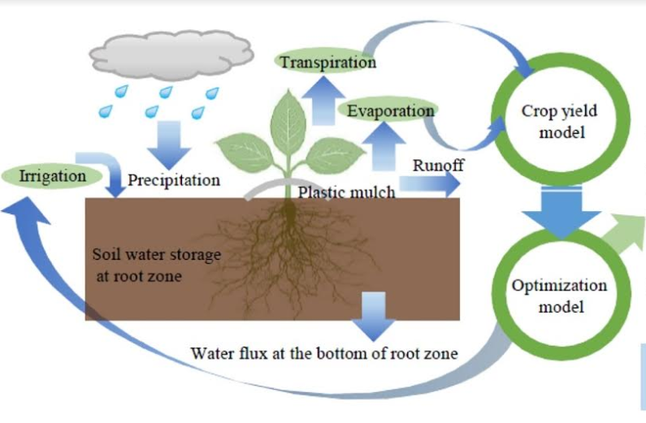
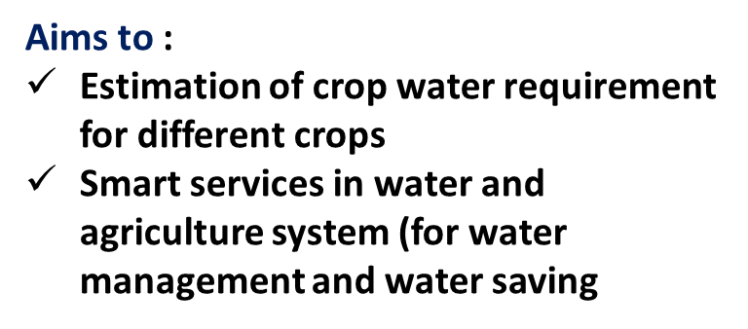
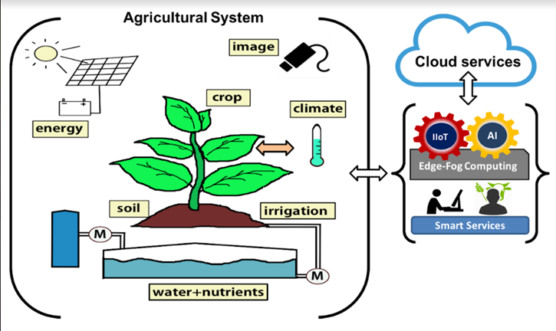
Application of near real time daily AET Product
Crop Water Requirement
Irrigation Scheduling
Irrigation System Performance Assessment
Relative Yield Estimation
Product utility

Slide 16
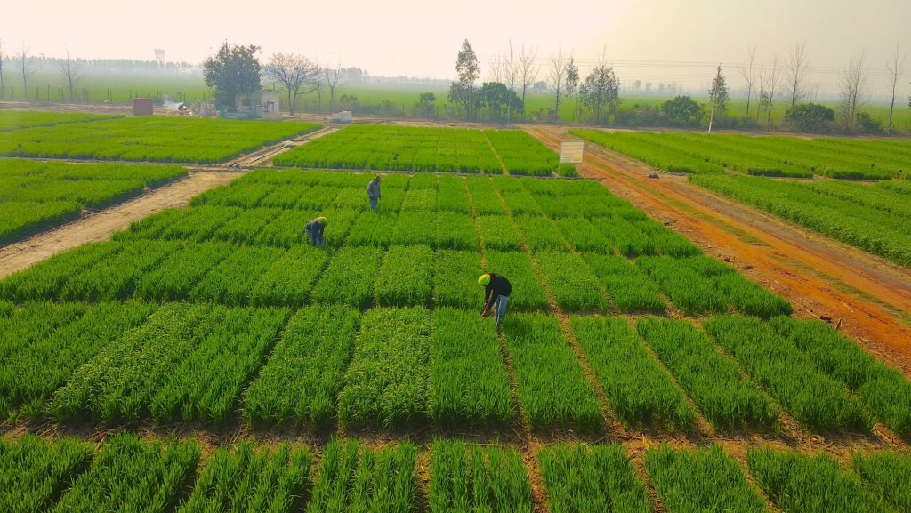
Thank you for kind attention

